Slide 1
How Modified Atmosphere Packaging (MAP) can reduce fresh crops losses and maintain quality Prof. Noureddine Benkeblia Dr Andrea Goldson Barnaby

Slide 2
Overview
Introduction
Types of Packaging
Reasons for Packaging
Active Packaging
Modified Atmosphere Packaging

Slide 3
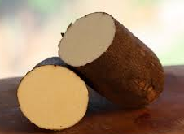
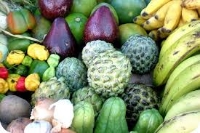
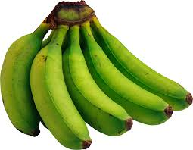
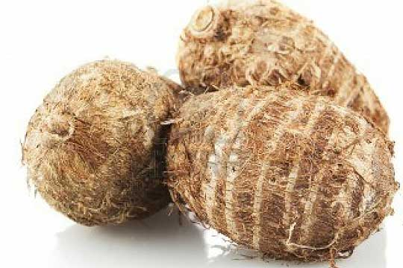
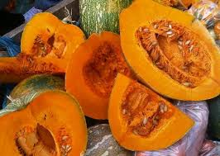
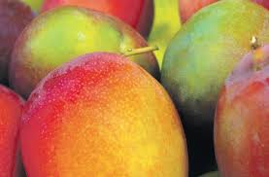
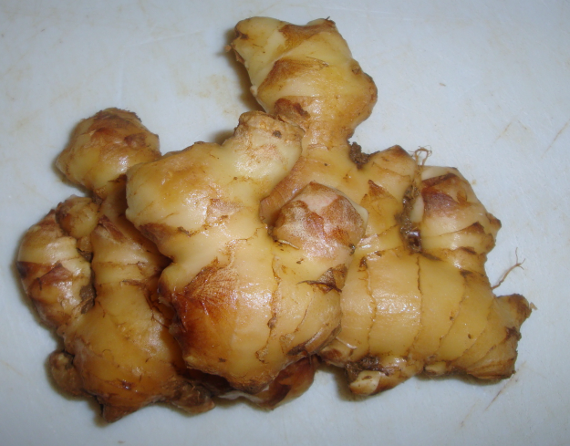
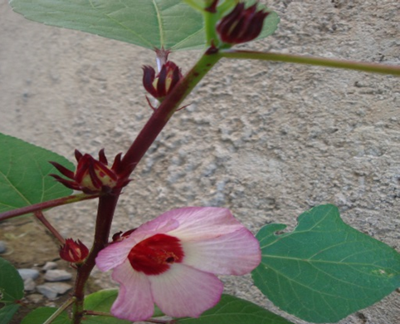
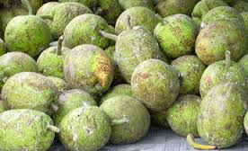
Agriculture Produce
Notes:
Jamaica has a wide array of agriculture crops. What can we do to extend the shelf life of our produce?

Slide 4
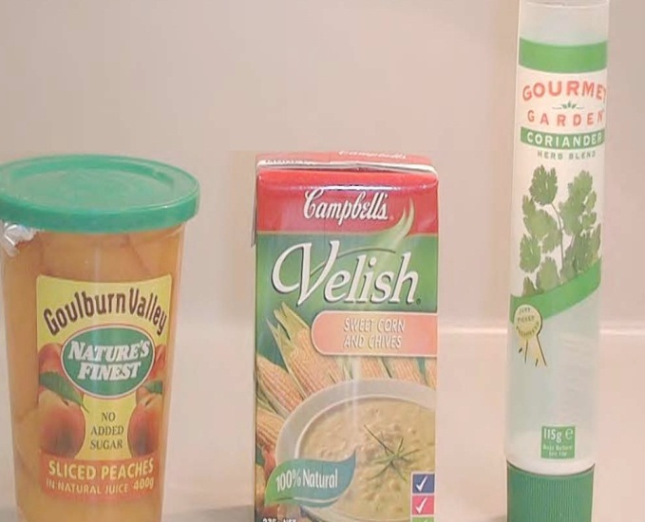
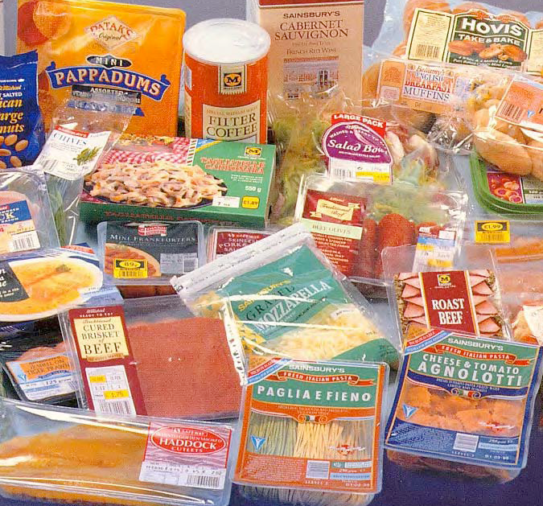
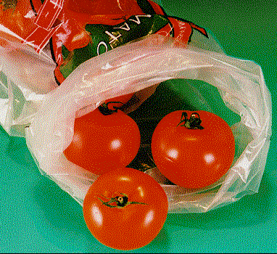
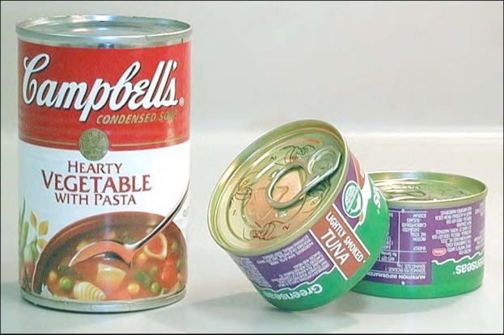
Food Packaging
Notes:
Packaging comes in a wide variety of forms. Plastics, paperboard, cans etc. What package is best for your produce?
There are various forms of food packaging. Today however we will focus on Modified Atmosphere Packaging

Slide 5
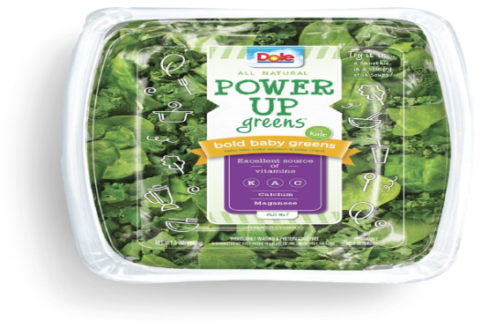
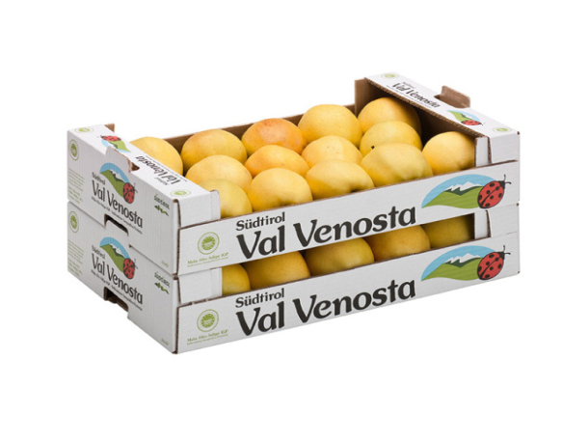
What is the reason for packaging?
Containment
Protection
Preservation
Distribution
Identification
Communication
Convenience
Notes:
Packaging serves many functions which includes, containment, distribution, labeling, protection, advertizing, convenience

Slide 6
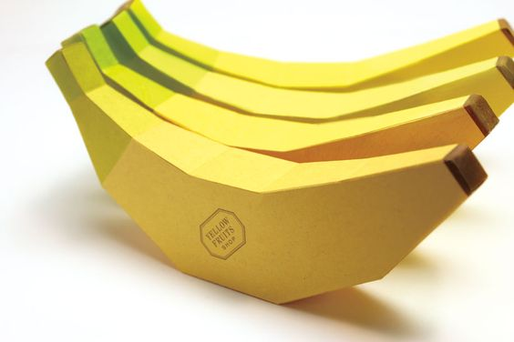
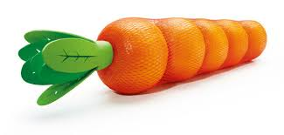
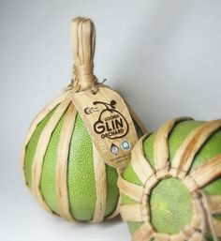
New Innovative Fruit Packaging Designs
Notes:
Packaging comes in a wide variety of forms and shapes and is also used to market the product

Slide 7
Protection
A good package will protect its contents from the environment
Protection may be from water vapor, oxygen, light, microorganisms, other contaminants, vibration, shock
Packaging can function to preserve and/or extend the shelf life of food products

Slide 8
Preservation
Other ways packaging can preserve foods include:
Acting as a barrier to water vapor, oxygen, carbon dioxide, other volatiles and contaminants, light and microorganisms
Interacting with the product to extend shelf life (active packaging)
Notes:
Interaction of the product to extend shelf life is known as Active Packaging

Slide 9
FRUITS VEGETABLES
Notes:
Active packaging may be utilized to extend the shelf life of produce. This is crucial especially in developing countries that have a high percentage of post harvest loses. This slide show the percentage of post-harvest losses of fruits and vegetables in the developed and developing countries.

Slide 10
Active Packaging
Active packaging, also known as interactive or smart packaging involves interaction between the packaging components and the food product
Active packages respond to changes in the internal or external environment by changing their own properties or attributes to enhance the preservation of food products while maintaining nutritional quality
Active substances are contained in sachets, or incorporated directly into the packaging component
Notes:
Active substances are contained in sachets or incorporated directly into the packaging component

Slide 11
Major active packaging technologies
Oxygen scavengers
Ethylene scavengers
Moisture regulators
Antimicrobial agents

Slide 12
Oxygen scavengers
The majority of commercially available oxygen scavengers work on the principle of oxidation of iron powder by chemical means or enzymes to prevent the deterioration of food constituents by oxidation or spoilage
This oxidation of the iron removes oxygen from the package and limits oxygen interaction with the food product
In the enzyme systems, an enzyme such as glucose oxidase reacts with a substrate to scavenge oxygen

Slide 13
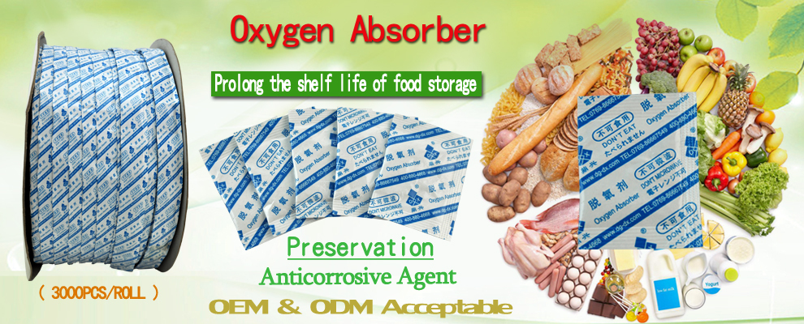

Slide 14
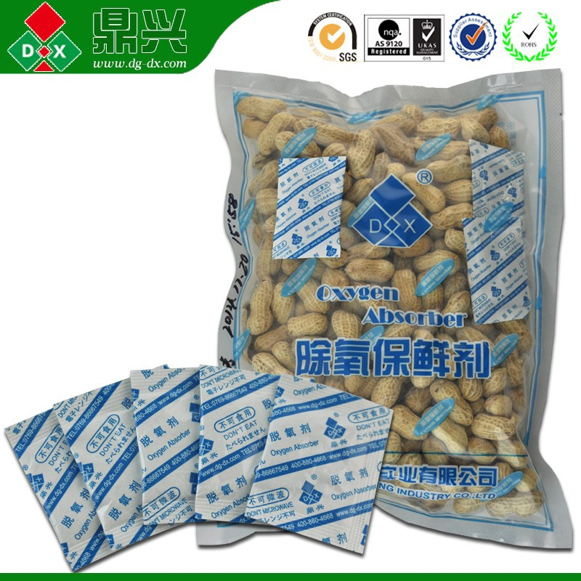
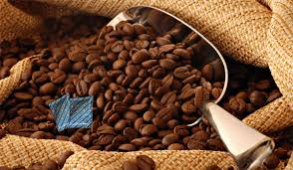

Slide 15
Ethylene scavengers
Ethylene acts as a growth hormone and accelerates ripening and senescence of fruits
Removing ethylene from the environment surrounding a fruit can extend the shelf life of the fruit
Most ethylene scavengers are based on potassium permanganate which oxidizes ethylene to acetate and ethanol

Slide 16
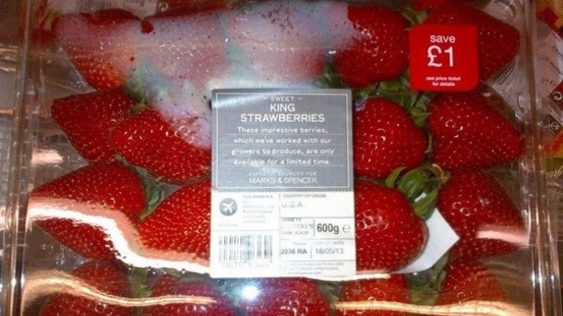
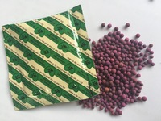
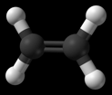
Potassium permanganate is an oxidizer that reacts with the ethylene in air and releases carbon dioxide and water

Slide 17
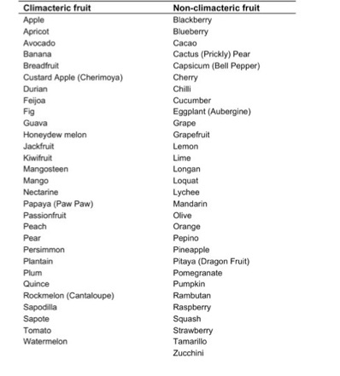
Climacteric fruit produce much larger quantities of ethylene

Slide 18
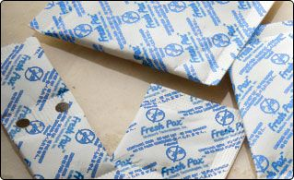
Moisture regulators
Desiccants such as silicates and humidity controlling substances are used in food packaging to control the moisture content inside the package of very dry foods or of respiring, wet and high relative humidity fresh/minimally processed foods
Notes:
Silicates are used to control humidity

Slide 19
Antimicrobial regulators
Antimicrobial agents such as sorbates, benzoates, ethanol and bacteriocins are incorporated into or onto polymeric packaging materials to reduce the microbial growth on the surface of food products
In some packaging systems, these antimicrobial agents are released from the packaging film into the food product over time

Slide 20
Packaging in the tropics
Principal function of packaging:
“To protect the packaged product against contamination & all types of deterioration & spoilage during its useful storage life”
Tropical environment:
High humidity
Fluctuating temperature

Slide 21
THE TYPES OF ATMOSPHERE MANIPULATION INSIDE THE PACKAGE ARE: 1. Controlled Atmosphere Packaging (CAP) 2. Modified Atmosphere Packaging (MAP) 3. Vacuum Packaging

Slide 22
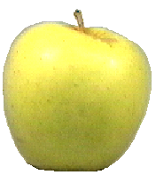
Fresh CROP is STILL ALIVE Respiratory activity of a fresh harvested produce
O₂
CO₂
H₂O
C₂H₄
Heat

Slide 23
Potato
Storage potential
Carrot
Green tomato
Asparagus
Mushroom
Lettuce
Spinach
Brussels
sprouts
Initial respiration rate at 15°C

Slide 24
Modified atmosphere packaging
Modified Atmosphere Packaging (MAP) is a technique used for prolonging the shelf-life period of fresh or minimally processed foods.
In this preservation technique the air surrounding the food in the package is changed to another composition.
This way the initial fresh state of the product may be prolonged.

Slide 25
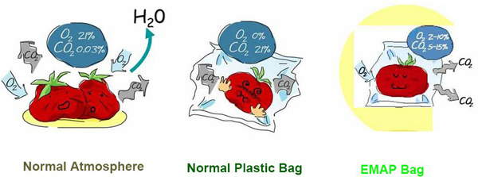
EMAP: Equilibrium modified atmosphere packaging
Notes:
Equilibrium modified atmosphere packaging

Slide 26
MODIFIED ATMOSPHERE PACKAGING (MAP)
→ The initial application of an atmosphere other than air with no further control of the atmosphere
APPLICATION
Quantities of fresh vegetables and fruits are transported under modified atmosphere condition

Slide 27
Gas diffusion in and out of a MA package
Intelligent &
Active
Packaging?
High O₂ (20%)
Low CO₂ (0%)
O₂
Atmosphere MAINTAINED by the Packaging
Low O₂
High CO₂
CO₂
Fresh
Produce
CO₂
Atmosphere Created by the Respiration of the Crop
RESPIRATION
O₂

Slide 28
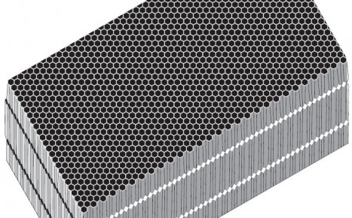
Number of Perforations per cm²
Thickness
- More Pores → Higher is the Gas Diffusion
- Thicker is the film → Lower is the Gas Diffusion

Slide 29
Principles of MAP Preservation
Reduce microbiological growth
Reduce spoilage
Reduce respiration rate
Reduce browning by application of heat
Condition: the temperature of storage the lower the better
Storage Life
2 times in room temperature + MAP
4 times in refrigerated temperature + MAP
Notes:
Refrigerated temperatures are better than room temperature

Slide 30
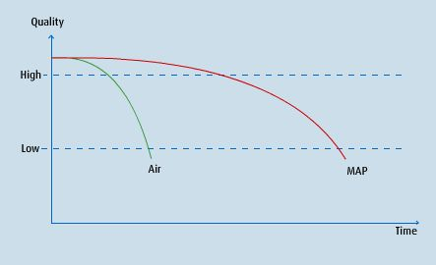
MAP and Shelf-Life Extension of
Fresh Crops

Slide 31
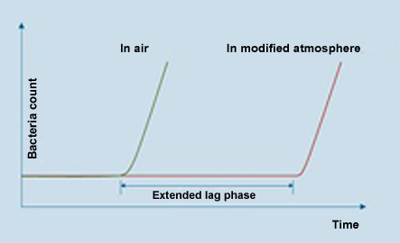
MAP and Shelf-Life Extension of
Fresh Crops

Slide 32
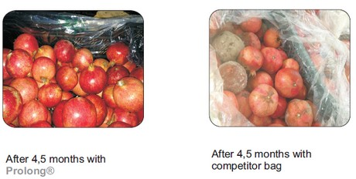
4.5 Months at 5°C + MAP 4.5 Months with
normal PE film

Slide 33
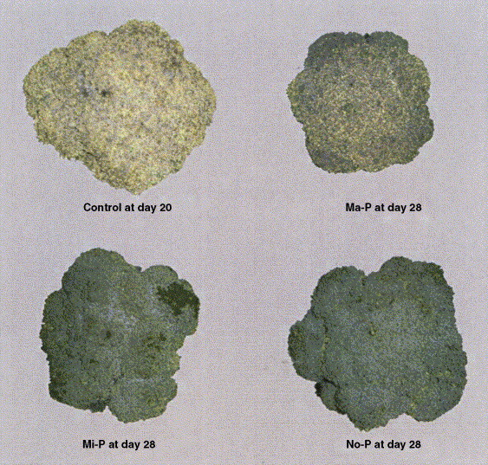
Cold storage of Broccoli as affected by modified atmosphere packaging

Slide 34
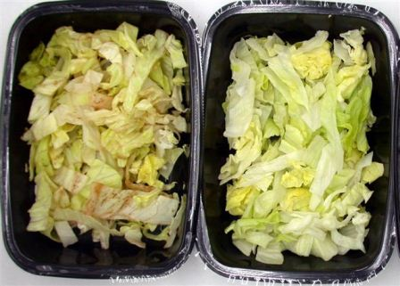
Cold storage of fresh-cut lettuce as affected by modified atmosphere

Slide 35
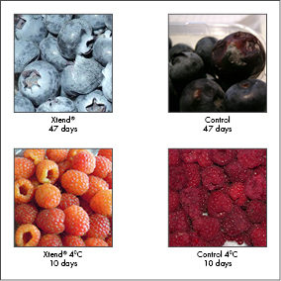

Slide 36
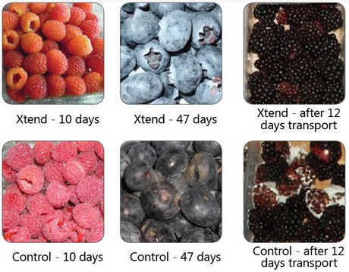

Slide 37
Xtend
The unique blend of polymers used in Xtend packaging allows for the development of such fungistatic CO2 concentrations within the packaging environment, which contributes significantly to inhibiting decay causing microorganisms such as Botrytis and prolonging storability of berries.
The elevated CO2 concentrations coupled with low O2 concentrations in Xtend packaging also slow down respiration and aging processes.

Slide 38
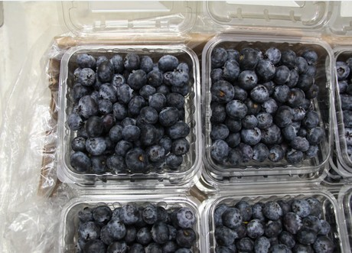

Slide 39
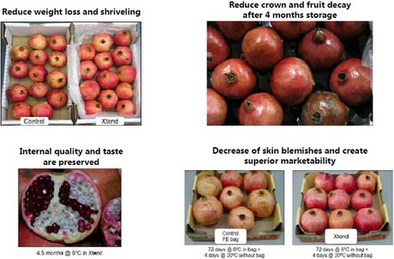

Slide 40
Conclusion
Packaging is important for protection and preservation of your produce
Active packaging may be used to enhance the shelf life of a product
Modified atmosphere packaging alters the environment of the produce to extend shelf life

Slide 41
Yeh Mon, THANK YOU for keeping me Fresh as Fresh
You good
now?

